Slide 1
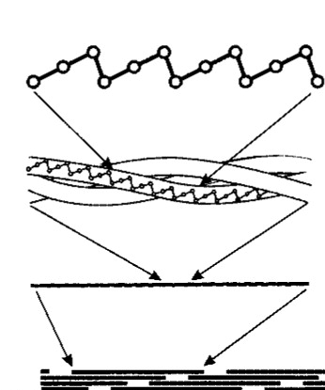

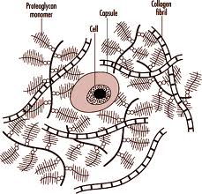
Interactions between Proteoglycan and Collagen depends on their structure
Joël Sandé

Slide 2
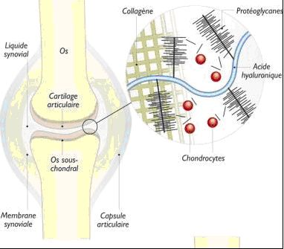
Background :
Main proteins of cartilage
Purpose : Study interactions + to detect the parts of theirs structures involved in such interactions
Method :
aggrecan, decorin and biglycan as proteoglycan
collagen type I and II

Slide 3
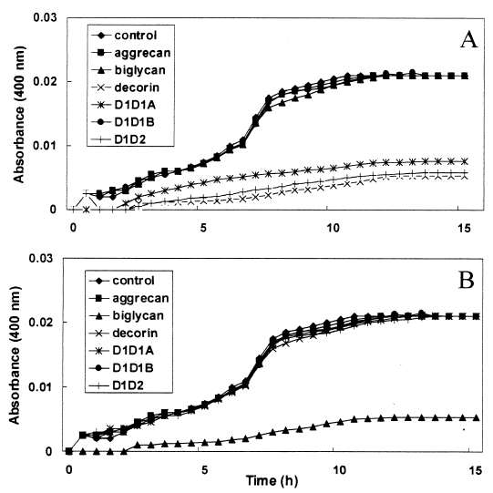
Tests & Results
Effet of proteoglycan on the formation of collagen fibrils in vitro by solid phase assay.
Collagen type I inhibed by Decorin
D1D1A
D1D2
Formation of fibrils at 37 °C for about 12 h
Collagen type II inhibed by Byglican

Slide 4
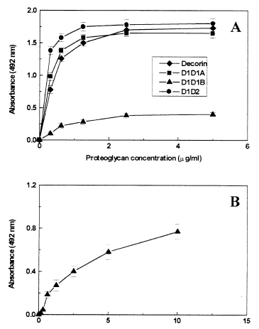
Tests & Results
Submitted sample to immunochemical quantification
Collagen type I interact with decorin, D1D1A and D1D2
Collagen type II interact with Byglican

Slide 5
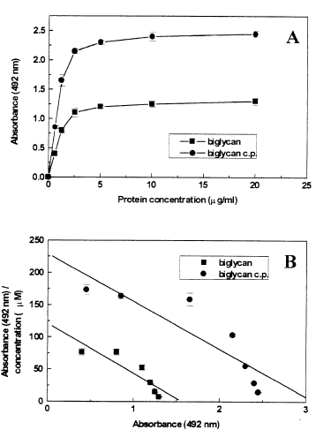
Tests & results
Effect of proteoglycan core protein was then examined
Increasing of interaction with core protein than in simple in case of Biglycan
Kd is the same
Dependant on the middle
A -> B+C
Kd = BC/A
GAG doesn’t plays any role here

Slide 6
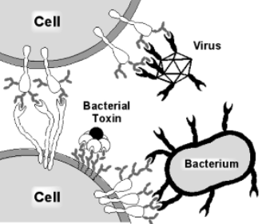
Test & Results
None of the squid proteoglycan (decorin, D1D1A and D1D2) core interacts with collagen -> (hypothesis) the interactions are electrostatics and mediated by the GAG chain
The source of collagen type I or II did not affect the interactions -> amino-acid

Slide 7
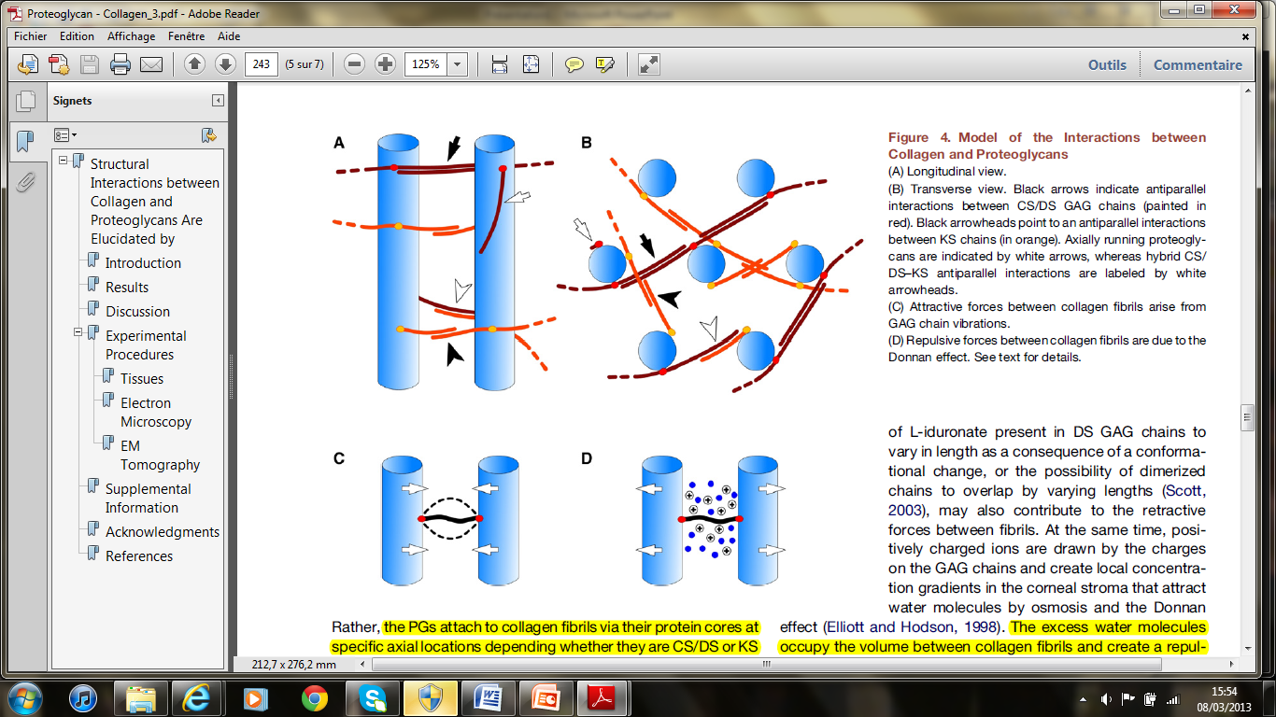
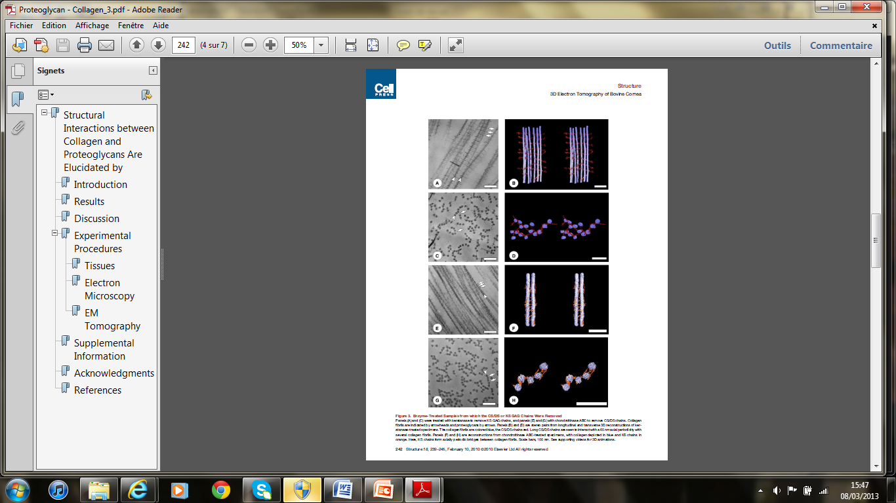
Model 1
Some PGs that form bridges between fibrils bridge adjacent fibrils only tangentially, so that a PG chain often extends between more than two collagen fibrils
they can conceivably break and reform repeatedly

Slide 8
Model 2
Multiple direct proteoglycan bridge between collagen fibers
attraction exerted by the proteoglycan opposing the positive charges between the fibrils repulsing each other

Slide 9
Conclusion
Knowing that proteoglycan have different structures, the interactions between those macromolecules depend strongly on their structures.
Collagen might play a role, but it’s mostly proteoglycan for what we know so far.

Slide 10

References
Demitrios H. Vynios*, Nicoletta Papageorgakopoulou, Helen Sazakli, Constantine P. Tsiganos. The interactions of cartilage proteoglycans with collagens are determined by their structures. Biochimie 83 (2001) 899−906
Philip N. Lewis, Christian Pinali, Robert D. Young, Keith M. Meek, Andrew J. Quantock, and Carlo Knupp. Structural Interactions between Collagen and Proteoglycans Are Elucidated by Three-Dimensional Electron Tomography of Bovine Cornea. Structure 18, 239–245, February 10, 2010

